Slide 1
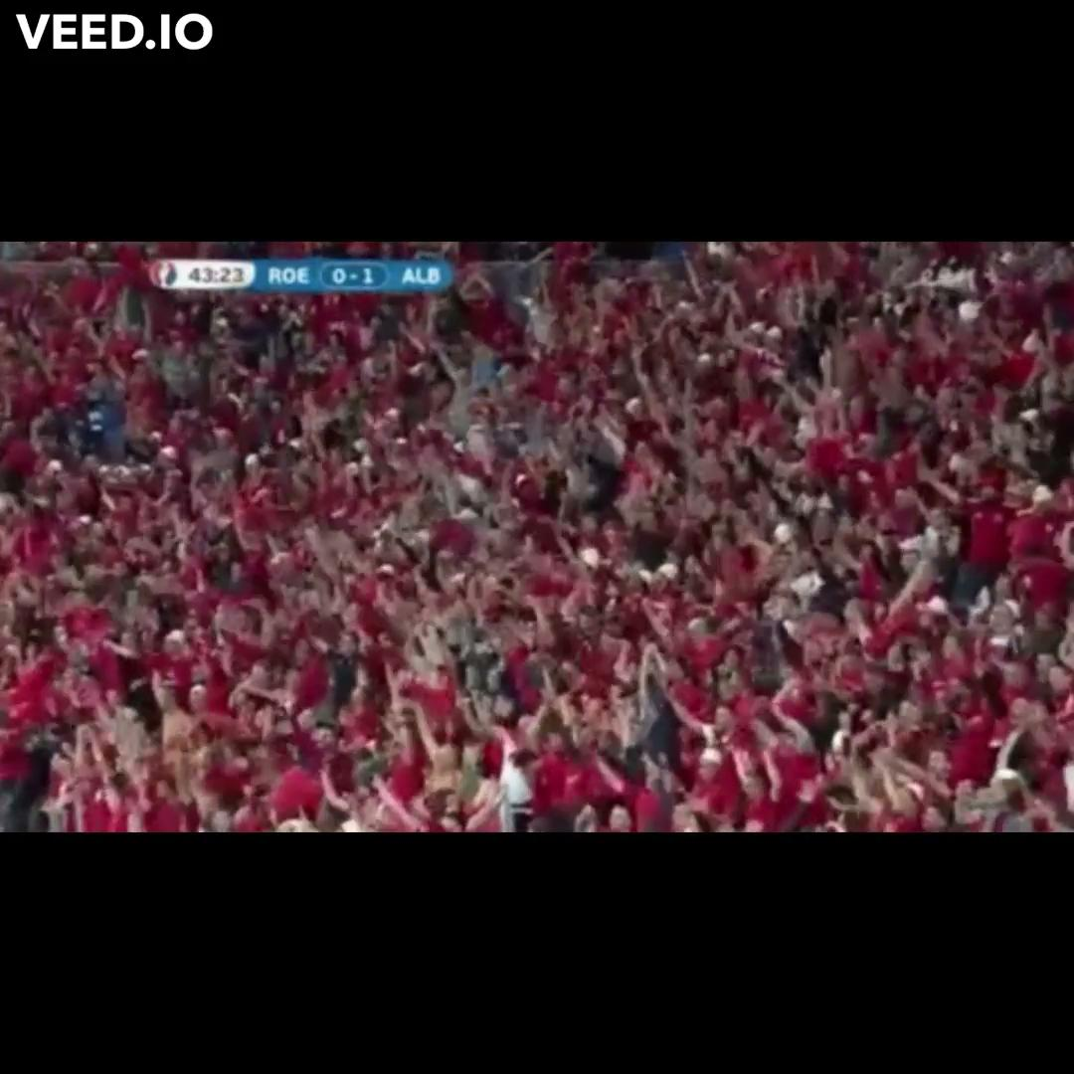

Slide 2

How to Win the English Premier League
Faizan Husain, Luke Ruan, Akhil Thakur, Neethi Thangiah
*approved by Cristiano Ronaldo

Slide 3
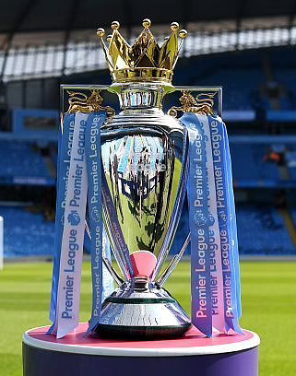

What is the English Premier League?
Highest level of English football
Most-watched sports league in the world
$4 billion in TV revenue from 2019-2020
In 2018-2019, over 14.5 million fans attended EPL matches

Slide 4
Our Data
Sourced from Kaggle
Detailed information on the past 20 years of EPL matches (over 7000 matches)
Attributes include:
Home/Away team
Full time and Halftime score and results
Shots and shots on target
Fouls
Corner kicks
etc.

Slide 5
Question of Interest
Which factors are the most influential on a team’s chances of winning a given match?
Home Field Advantage?
Halftime Lead?
Shots Taken vs. Shots On Target vs. Goals Scored
How Important Are Fouls?

Slide 6
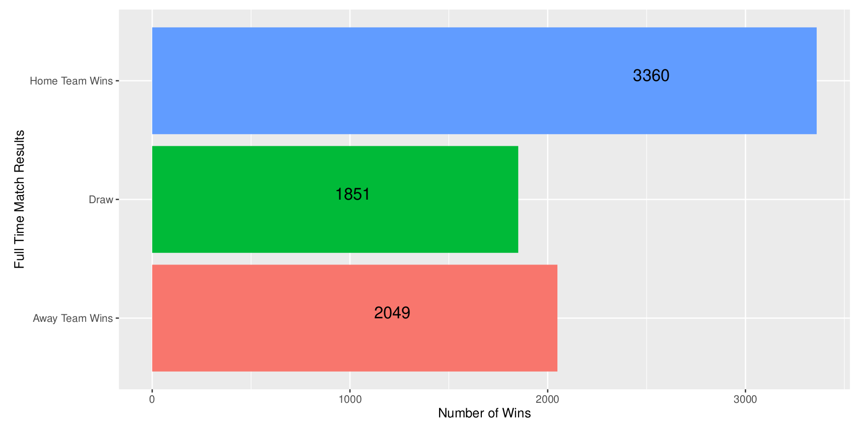
Proportion of Home Team Wins

Slide 7
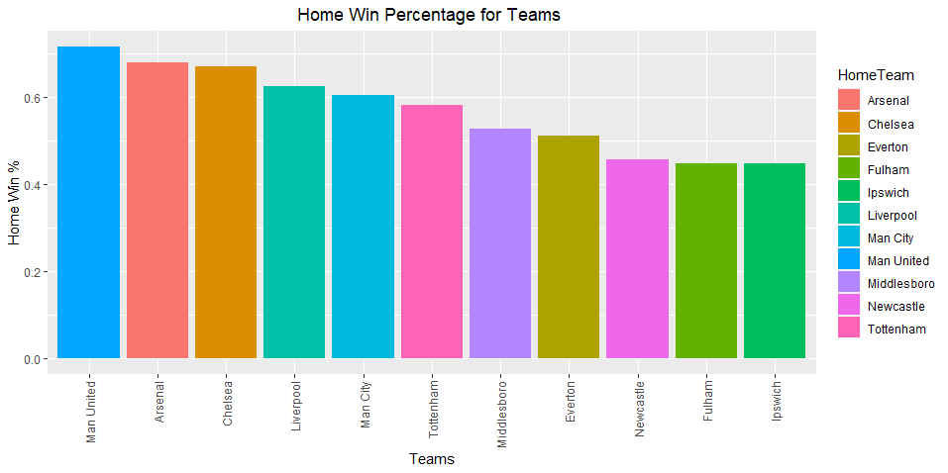
Home Field Winning % by Team

Slide 8
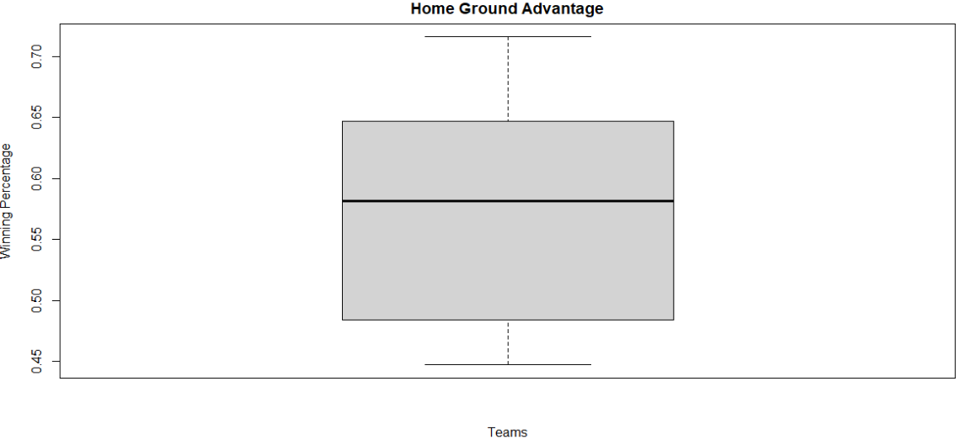
Home Field Winning Percentage

Slide 9
Takeaway
It can be concluded that:
Number of wins on home field significantly outnumbers both losses and draws
Median winning percentage on home field is >55%
Therefore:
There seems to be a correlation between playing on home field and a higher win percentage

Slide 10
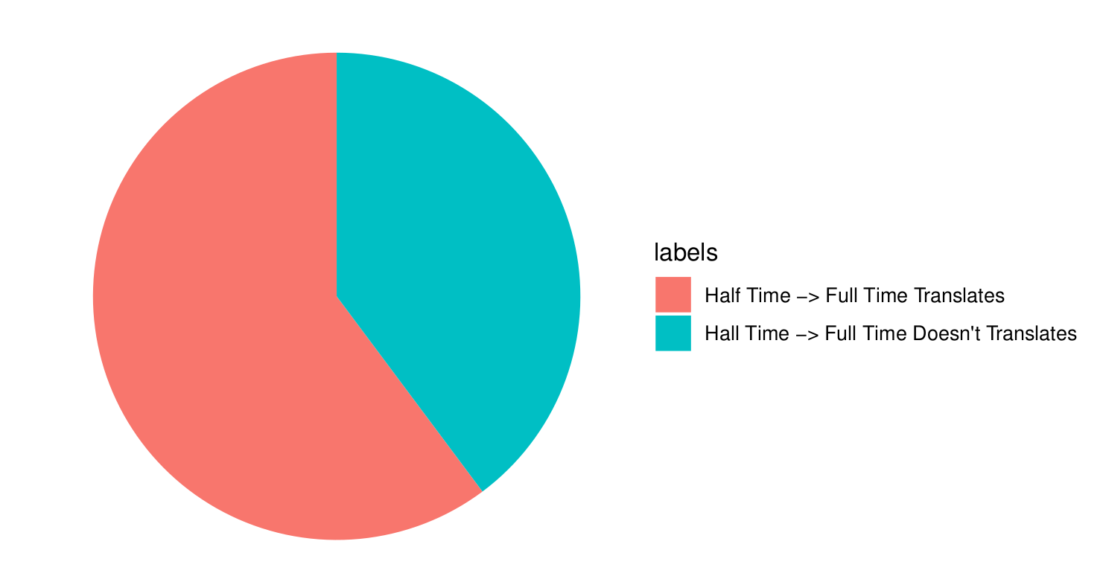
Do Halftime Leads Translate to Full-time Wins?
Halftime lead -> Full-time Win
Halftime lead -> Full-time Loss

Slide 11
Takeaway
Most of the time, winning team at halftime will win the game.
~40% of the time, the losing team at halftime will come back to win

Slide 12
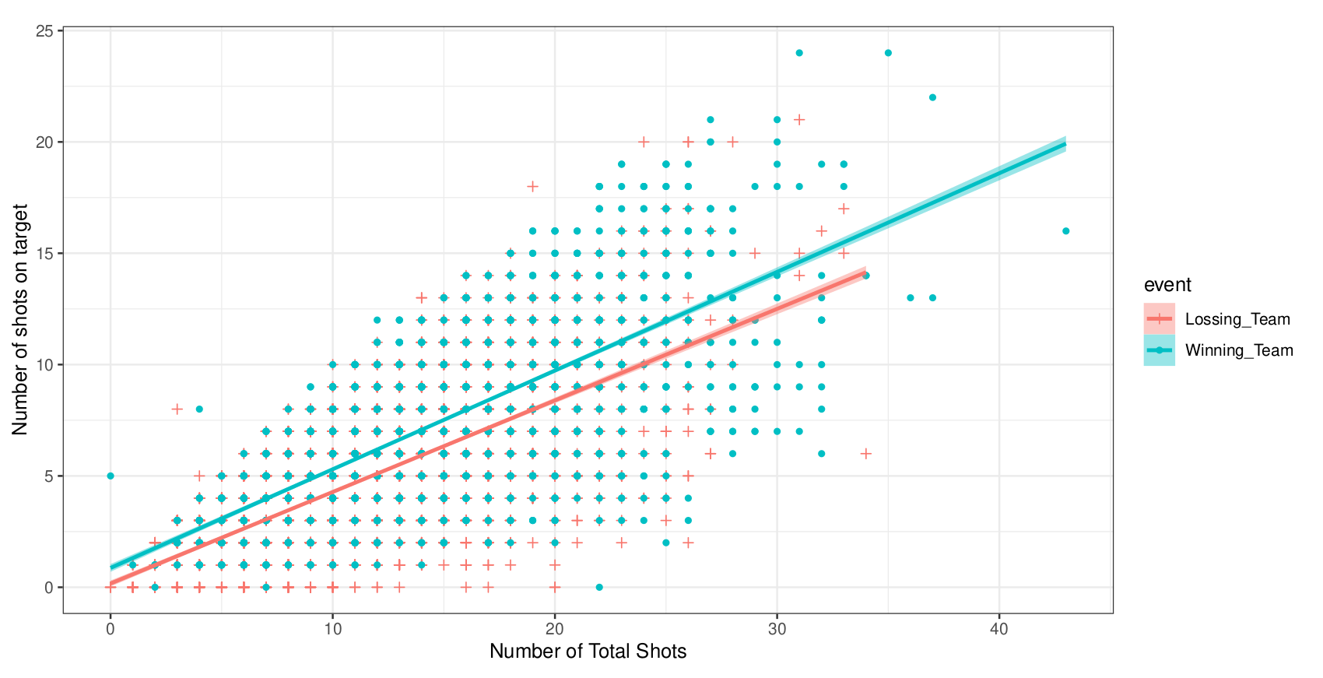
Shots Taken vs. Shots On Target
Losing team
Winning team

Slide 13
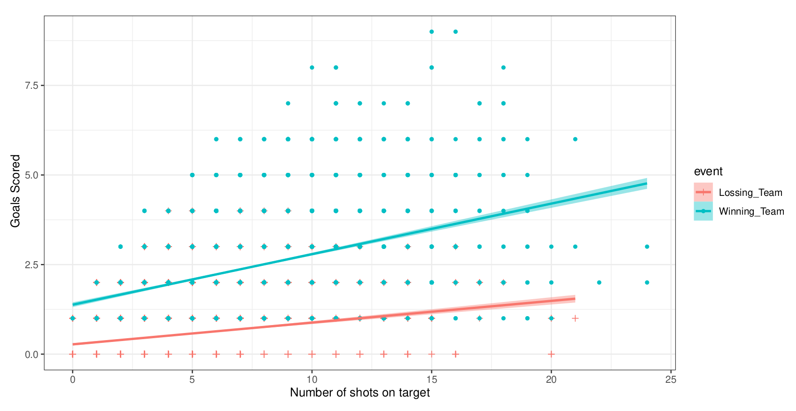
Shots On Target vs. Goals Scored
Losing team
Winning team

Slide 14
Takeaway
Positive correlation between both:
Shots Taken and Shots On Target
Shots On Target and Goals Scored
Therefore, take more shots!

Slide 15
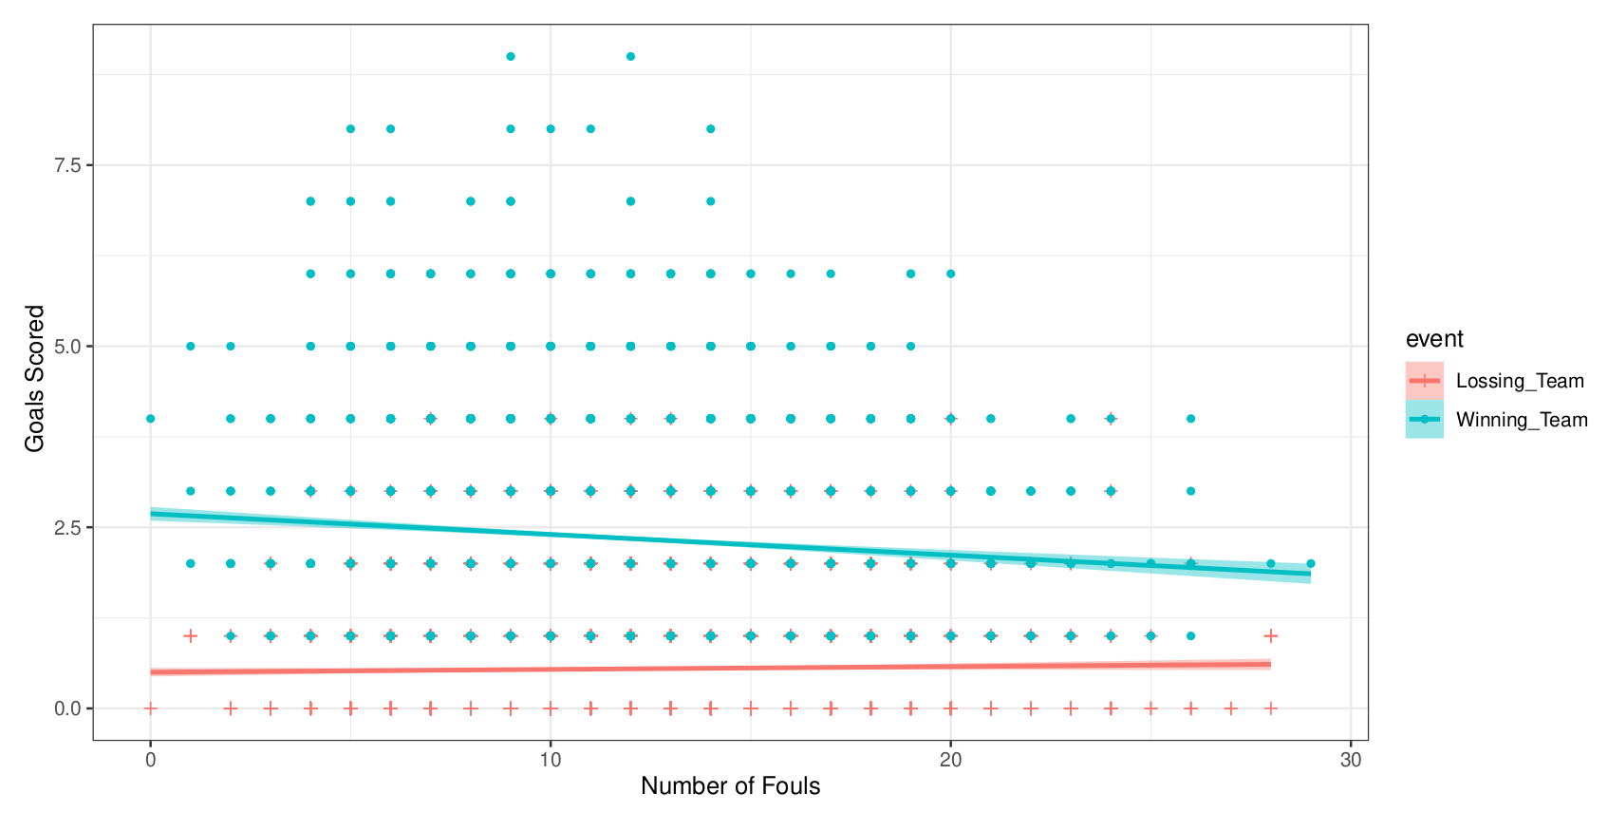
Fouls Committed vs. Goals Scored
Losing team
Winning team

Slide 16
Takeaway
Negative correlation between fouls committed and goals scored for the winning team
Therefore, commit less fouls

Slide 17
Formula For Victory
Play on your home field!
Get an early lead
Take more shots
Commit fewer (or smarter) fouls

Slide 18
Possible Biases
Only looked at EPL
What about analyses of other leagues?
Recent years vs. past 20 years
Other attributes?

Slide 19
Questions?

